Slide 1
Chapter 2 Basic Structures: Sets, Functions, Sequences, and Sums
Discrete Mathematics
and Its Applications
Sixth Edition
By Kenneth Rosen

Slide 2
Outlines
2.1 Sets
2.2 Set Operations
2.3 Functions
2.4 Sequences and Summations

Slide 3
Getting Started
2.1 Sets
2.2 Set Operations
2.3 Functions
2.4 Sequences and Summations

Slide 4
2.1 Sets(1/8)
Definition 1: A set is an unordered collection of objects
Definition 2: Objects in a set are called elements, or members of the set.
a ∈ A, a ∉ A
V = {a, e, i, o, u}
O = {1, 3, 5, 7, 9} or O = {x|x is an odd positive integer less than 10} or O = {x∈Z⁺|x is odd and x<10}

Slide 5
2.1 Sets(2/8)
N={0, 1, 2, 3, …}, natural numbers
Z={…,-2, -1, 0, 1, 2, …}, integers
Z⁺={1, 2, 3, …}, positive integers
Q={p/q|p∈Z, q∈Z, and q≠0}, rational numbers
Q⁺={x∈R|x=p/q, for positive integers p and q}
R, real numbers

Slide 6
2.1 Sets(3/8)
Definition 3: Two sets are equal if and only if they have the same elements. A=B iff ∀x(x ∈ A ↔ x ∈ B)
Venn diagram
Universal set U
Empty set (null set) ∅ (or {})

Slide 7
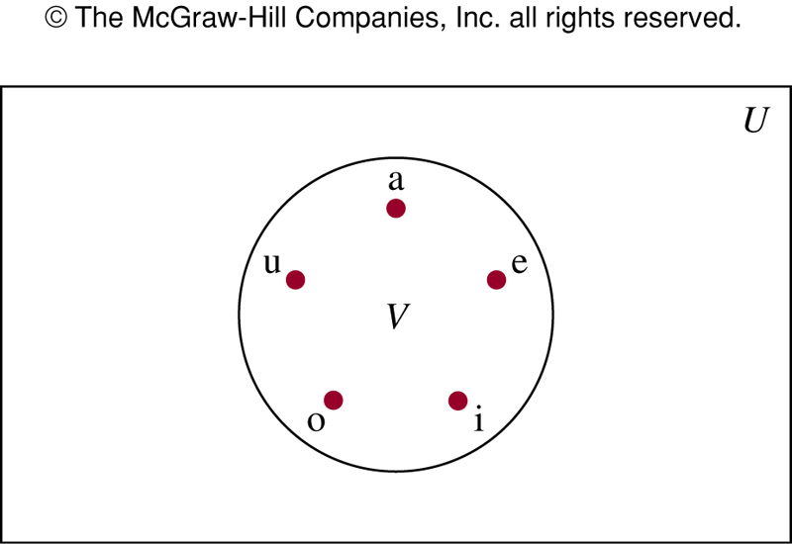
FIGURE 1 (2.1)
FIGURE 1 Venn Diagram for the Set of Vowels.
P. 114
Notes:
p:\msoffice\My Projects\Rosen 6e 2007\Imagebank\JPEGs07-24-06\ch02\jpeg\02_1_001.jpg

Slide 8
2.1 Sets(5/8)
Definition 4: The set A is a subset of B if and only if every element of A is also an element of B. A ⊆ B iff ∀x(x ∈ A → x ∈ B)
Theorem 1: For every set S, (1) ∅ ⊆ S and (2) S ⊆ S.
Proper subset: A ⊂ B ∀x(x ∈ A → x ∈ B) ∧ ∃x(x ∈ B ∧ x ∉ A)

Slide 9
2.1 Sets(6/8)
If A⊆B and B⊆A, then A=B
Sets may have other sets as members
A={∅, {a}, {b}, {a,b}} B={x|x is a subset of the set {a,b}}
A=B

Slide 10
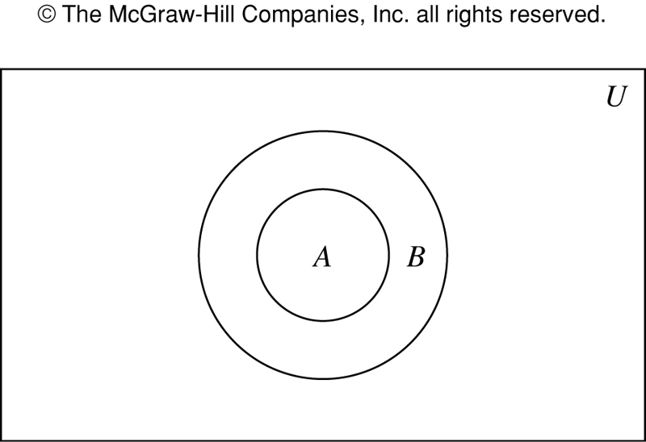
FIGURE 2 (2.1)
FIGURE 2 Venn Diagram Showing that A Is a Subset of B.
Notes:
p:\msoffice\My Projects\Rosen 6e 2007\Imagebank\JPEGs07-24-06\ch02\jpeg\02_1_002.jpg

Slide 11
2.1 Sets(8/8)
Definition 5: If there are exactly n distinct members in the set S (n is a nonnegative integer), we say that S is a finite set and that n is the cardinality of S. |S|= n
|∅|=0
Definition 6: A set is infinite if it’s not finite.
Z⁺

Slide 12
The Power Set
Definition 7: The power set of S is the set of all subset of the set S. P(S)
P({0,1,2})
P(∅)
P({∅})
If a set has n elements, then its subset has 2^{n} elements.

Slide 13
Cartesian Products
Definition 8: Ordered n-tuple (a₁, a₂, …, a_{n}) is the ordered collection that has a_{i} as its ith element for i=1, 2, …, n.
Definition 9: Cartesian product of A and B, denoted by A × B, is the set of all ordered pairs (a, b), where a ∈ A and b ∈ B. A × B = {(a, b)| a ∈ A ∧ b ∈ B}
E.g. A = {1, 2}, B = {a, b, c}
A × B and B × A are not equal, unless A=∅ or B=∅ or A=B

Slide 14
Definition 10: Cartesian product of A₁, A₂, …, A_{n}, denoted by A₁× A₂ × …× A_{n}, is the set of all ordered n-tuples (a₁, a₂, …, a_{n}), where a_{i} ∈ A_{i} for i=1,2,…,n. A₁× A₂ × …× A_{n} = {(a₁, a₂, …, a_{n})| a_{i} ∈ A_{i} for i=1,2,…,n}

Slide 15
Using set notation with quantifiers
∀x∈S (P(x)): ∀x (x∈S → P(x))
∃x∈S (P(x)): ∃x (x∈S ∧ P(x))
∃x : x^2 = 4 is true, since 2 is an x for which
x^ 2 = 4. On the other hand, ∀x : x^2 = 4 is clearly false; not all numbers, when squared, are equal to 4.

Slide 16
Truth sets of quantifiers
Given a predicate P, and a domain D, we define the truth set of P to be the set of elements x in D for which P (x) is true.
Then the truth set of P: {x ∈ D | P(x)}
For Example:
What are the truth sets of the predicates P (x), where the domain is the set of integers and P (x) is “|x| = 1”.
Solution: The truth set of P, {x ∈ Z | |x| = 1}, is the set of integers for which |x| = 1. Because |x| = 1 when x = 1 or x = −1, and for no other integers x, we see that the truth set of P is the set {−1, 1}.

Slide 17
Getting Started
2.1 Sets
2.2 Set Operations
2.3 Functions
2.4 Sequences and Summations

Slide 18
2.2 Set Operations
Definition 1: The union of the sets A and B, denoted by A∪B, is the set containing those elements that are either in A or in B, or in both.
A∪B={x|x∈A ∨ x∈B}
Definition 2: The intersection of the sets A and B, denoted by A∩B, is the set containing those elements in both A and B.
A ∩ B={x|x∈A ∧ x∈B}

Slide 19
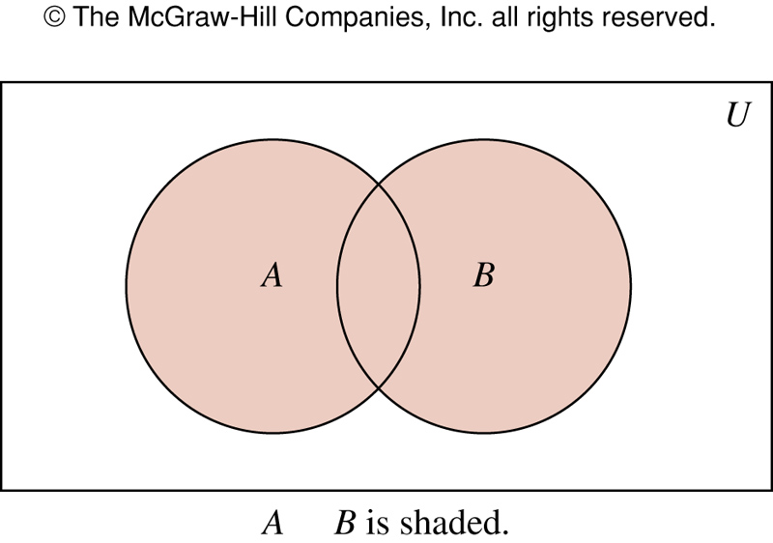
Figure 1 (2.2)
∪
FIGURE 1 Venn Diagram Representing the Union of A and B.
Notes:
p:\msoffice\My Projects\Rosen 6e 2007\Imagebank\JPEGs07-24-06\ch02\jpeg\02_2_001.jpg

Slide 20
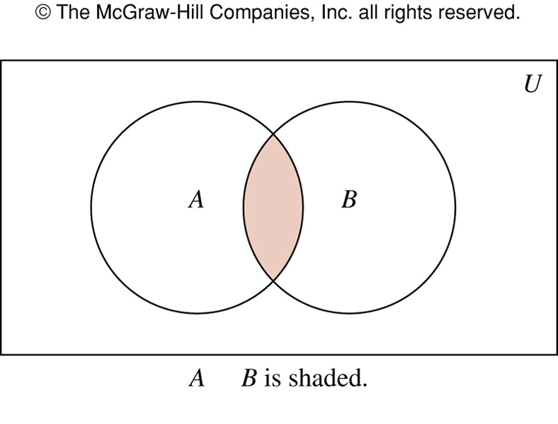
FIGURE 2 (2.2)
∩
FIGURE 2 Venn Diagram Representing the Intersection of A and B.
Notes:
p:\msoffice\My Projects\Rosen 6e 2007\Imagebank\JPEGs07-24-06\ch02\jpeg\02_2_002.jpg

Slide 21
Definition 3: Two sets are disjoint if their intersection is the empty set.
|A∪B|=|A|+|B|-| A ∩ B |
Principle of inclusion-exclusion

Slide 22
Definition 4: The difference of the sets A and B, denoted by A-B, is the set containing those elements that are in A but not in B.
Complement of B with respect to A
A-B={x|x∈A ∧ x∉B}
Definition 5: The complement of the set A, denoted by Ā, is the complement of A with resepect to U.
Ā = {x|x∉A}

Slide 23
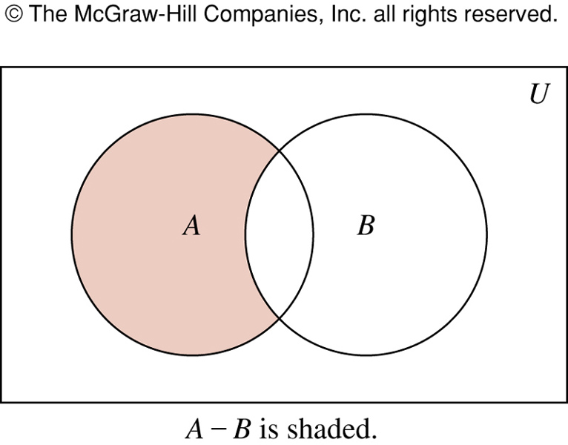
FIGURE 3 (2.2)
FIGURE 3 Venn Diagram for the Difference of A and B.
Notes:
p:\msoffice\My Projects\Rosen 6e 2007\Imagebank\JPEGs07-24-06\ch02\jpeg\02_2_003.jpg

Slide 24
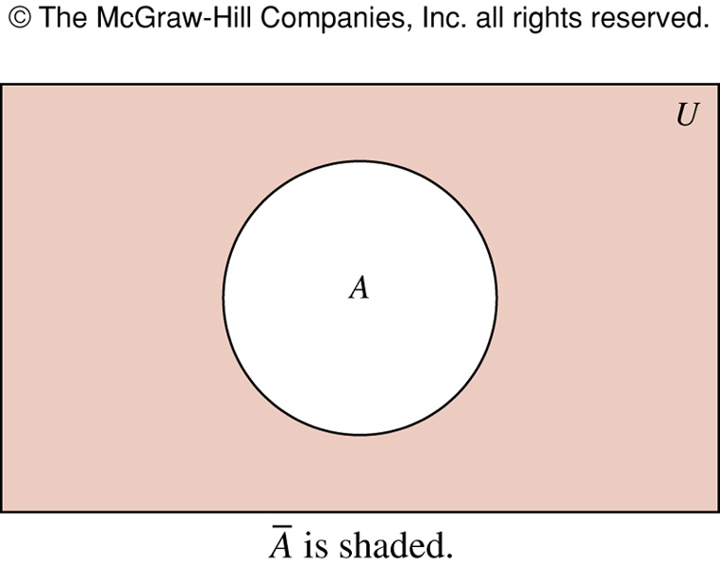
FIGURE 4 (2.2)
FIGURE 4 Venn Diagram for the Complement of the Set A.
Notes:
p:\msoffice\My Projects\Rosen 6e 2007\Imagebank\JPEGs07-24-06\ch02\jpeg\02_2_004.jpg

Slide 25
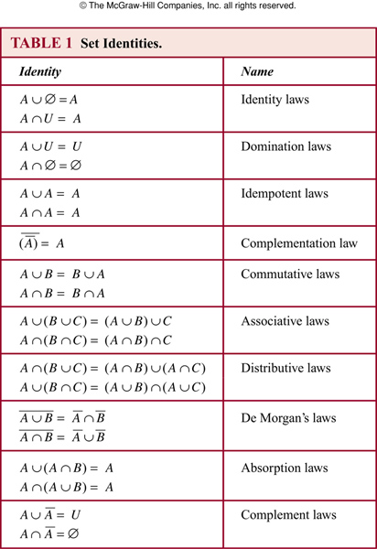
TABLE 1 (2.2)
Notes:
p:\msoffice\My Projects\Rosen 6e 2007\Imagebank\JPEGs07-24-06\ch02\jpeg\t02_2_01.jpg

Slide 26
Set Identities
To prove set identities
Show that each is a subset of the other
Using membership tables
Using those that we have already proved

Slide 27
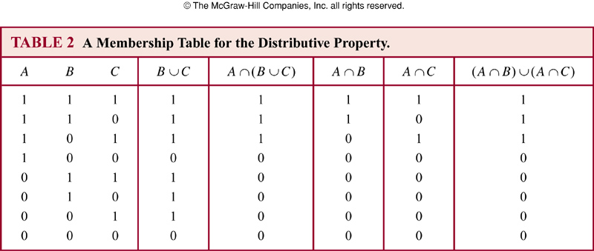
TABLE 2 (2.2)
Notes:
p:\msoffice\My Projects\Rosen 6e 2007\Imagebank\JPEGs07-24-06\ch02\jpeg\t02_2_02.jpg

Slide 28
Generalized Unions and Intersections
Definition 6: The union of a collection of sets is the set containing those elements that are members of at least one set in the collection.
A₁∪ A₂ ∪ … ∪ A_{n} =
Definition 7: The intersection of a collection of sets is the set containing those elements that are members of all the sets in the collection.
A₁∩ A₂ ∩ … ∩ A_{n} =
Computer Representation of Sets
Using bit strings

Slide 29
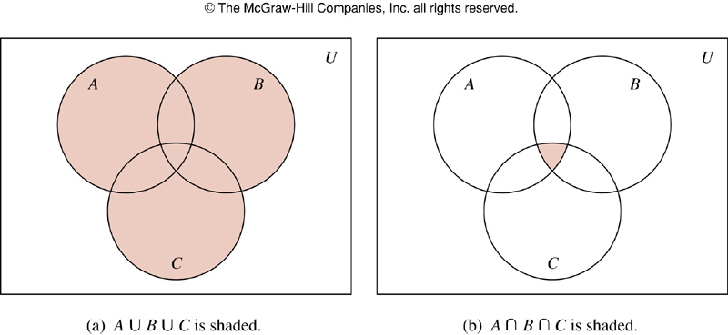
FIGURE 5 (2.2)
FIGURE 5 The Union and Intersection of A, B, and C.
P. 127
Notes:
p:\msoffice\My Projects\Rosen 6e 2007\Imagebank\JPEGs07-24-06\ch02\jpeg\02-2-005.jpg

Slide 30
Getting Started
2.1 Sets
2.2 Set Operations
2.3 Functions
2.4 Sequences and Summations

Slide 31
2.3 Functions
Definition 1: A function f from A to B is an assignment of exactly one element of B to each element of A. f: A→B
Definition 2: f: A→B.
A: domain of f, B: codomain of f.
f(a)=b, a: preimage of b, b: image of a.
Range of f: the set of all images of elements of A
f: maps A to B

Slide 32
FIGURE 1
x 2x+1
1
2
3
4
1
2
3
4
5
6
7
8
9
Range or Image
Domain
Co-domian
FIGURE 1.1: An example of function with it’s components.
Notes:
p:\msoffice\My Projects\Rosen 6e 2007\Imagebank\JPEGs07-24-06\ch02\jpeg\02-3-001.jpg

Slide 33
FIGURE 2
x 2x+1
1
2
3
4
1
2
3
4
5
6
7
8
Range or Image
Domain
Co-domian
FIGURE 1.2: An example of not being function
Notes:
p:\msoffice\My Projects\Rosen 6e 2007\Imagebank\JPEGs07-24-06\ch02\jpeg\02-3-001.jpg

Slide 34
FIGURE 3
a
b
c
d
1
2
3
4
5
6
7
8
9
Range or Image
Domain
Co-domian
FIGURE 1.3: An example of not being function
Notes:
p:\msoffice\My Projects\Rosen 6e 2007\Imagebank\JPEGs07-24-06\ch02\jpeg\02-3-001.jpg

Slide 35
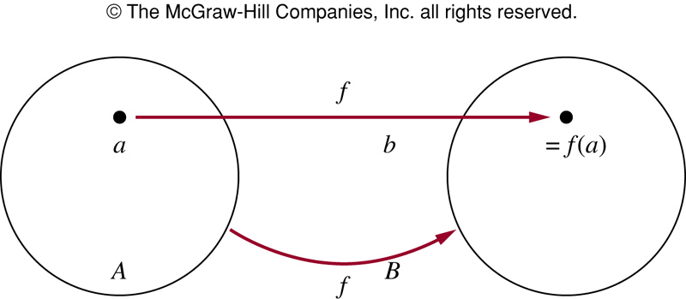
FIGURE 2 (2.3)
FIGURE 2 The Function f Maps A to B.
Notes:
p:\msoffice\My Projects\Rosen 6e 2007\Imagebank\JPEGs07-24-06\ch02\jpeg\02-3-002.jpg

Slide 36
Definition 3: Let f₁ and f₂ be functions from A to R. f₁+f₂ and f₁f₂ are also functions from A to R:
(f₁+f₂)(x) = f₁(x)+f₂(x)
(f₁f₂)(x)=f₁(x)f₂(x)
Definition 4: f: A→B, S is a subset of A. The image of S under the function f is: f(S)={t|∃s∈S(t=f(s))}

Slide 37
One-to-One and Onto Functions
Definition 5: A function f is one-to-one or injective, iff f(a)=f(b) implies that a=b for all a and b in the domain of f.
∀a∀b( f(a)=f(b) → a=b ) or ∀a∀b( a ≠ b → f(a) ≠ f(b) )
Definition 6: A function f is increasing if f(x)≤f(y), and strictly increasing if f(x)<f(y) whenever x<y. f is called decreasing if f(x)≥f(y), and strictly decreasing if f(x)>f(y) whenever x<y.

Slide 38
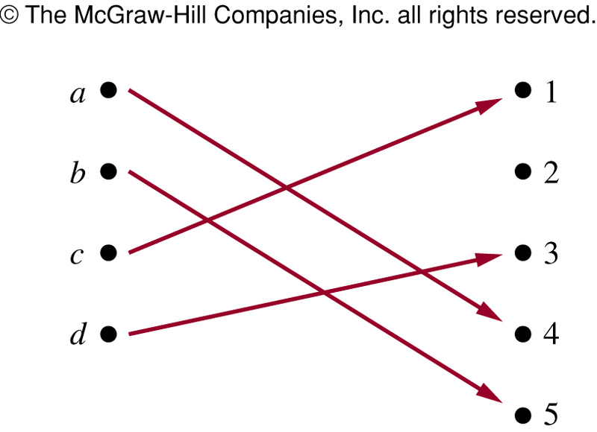
FIGURE 3 (2.3)
FIGURE 3 A One-to-One Function.
Notes:
p:\msoffice\My Projects\Rosen 6e 2007\Imagebank\JPEGs07-24-06\ch02\jpeg\02-3-003.jpg

Slide 39
One-to-One and Onto Functions
Definition 7: A function f is onto or surjective, iff for every element b∈B there is an element a∈A with f(a)=b.
∀y∃x( f(x)=y ) or ∀a∀b( a ≠ b → f(a) ≠ f(b) )
When co-domain = range
Definition 8: A function f is a one-to-one correspondence or a bijection if it is both one-to-one and onto.
Ex: identity function ι_{A}(x)=x

Slide 40
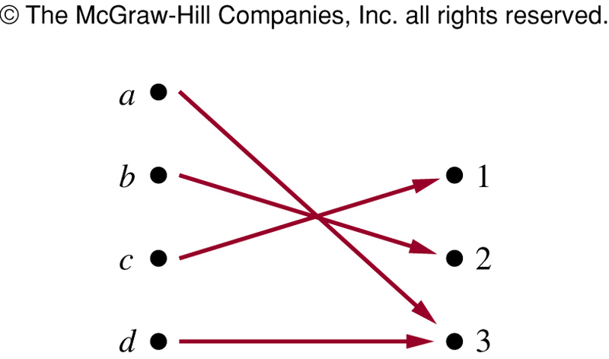
FIGURE 4 (2.3)
FIGURE 4 An Onto Function.
Notes:
p:\msoffice\My Projects\Rosen 6e 2007\Imagebank\JPEGs07-24-06\ch02\jpeg\02-3-004.jpg

Slide 41
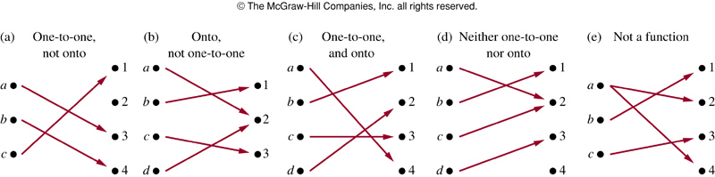
FIGURE 5 (2.3)
FIGURE 5 Examples of Different Types of Correspondences.
Notes:
p:\msoffice\My Projects\Rosen 6e 2007\Imagebank\JPEGs07-24-06\ch02\jpeg\02-3-005.jpg

Slide 42
Inverse Functions and Compositions of Functions
Definition 9: Let f be a one-to-one correspondence from A to B. The inverse function of f is the function that assigns to an element b in B the unique element a in A such that f(a)=b.
f⁻¹(b)=a when f(a)=b
Prove It
If a function is one-to-one correspondence then it’s inverse is possible

Slide 43
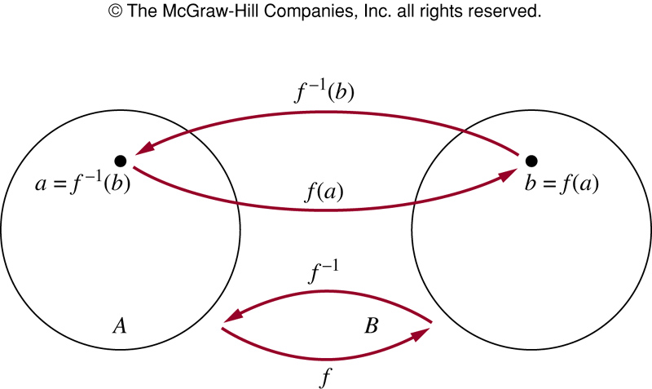
FIGURE 6 (2.3)
FIGURE 6 The Function f ^{－1} Is the Inverse of Function f.
Notes:
p:\msoffice\My Projects\Rosen 6e 2007\Imagebank\JPEGs07-24-06\ch02\jpeg\02-3-006.jpg

Slide 44
Definition 10: Let g be a function from A to B, and f be a function from B to C. The composition of functions f and g, denoted by f○g, is defined by:
f○g(a) = f(g(a))
f○g and g○f are not equal --- Prove it

Slide 45
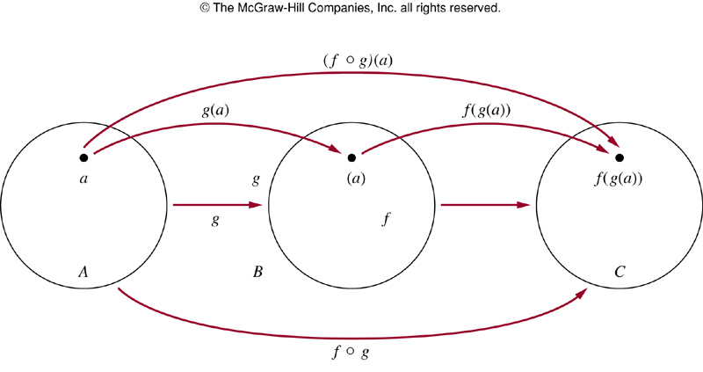
FIGURE 7 (2.3)
FIGURE 7 The Composition of the Functions f and g.
Notes:
p:\msoffice\My Projects\Rosen 6e 2007\Imagebank\JPEGs07-24-06\ch02\jpeg\02-3-007.jpg

Slide 46
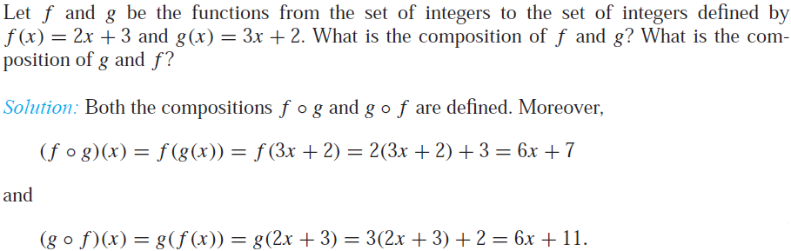

Slide 47
Graphs of Functions
Definition 11: The graph of function f is the set of ordered pairs {(a,b)|a∈A and f(a)=b}

Slide 48
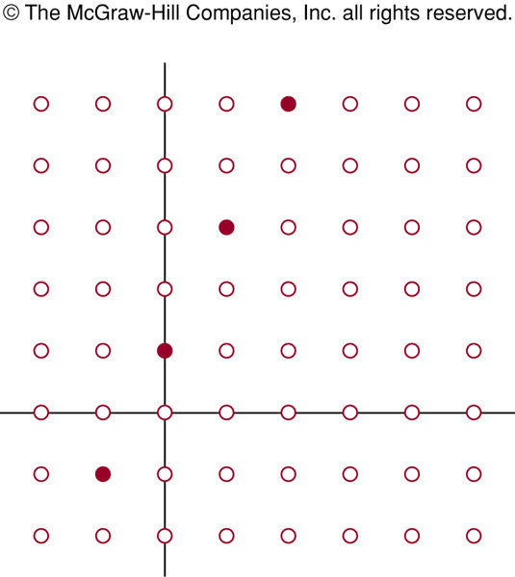
FIGURE 8 (2.3)
FIGURE 8 The Graph of f(n) = 2n + 1 from Z to Z.
Notes:
p:\msoffice\My Projects\Rosen 6e 2007\Imagebank\JPEGs07-24-06\ch02\jpeg\02-3-008.jpg

Slide 49
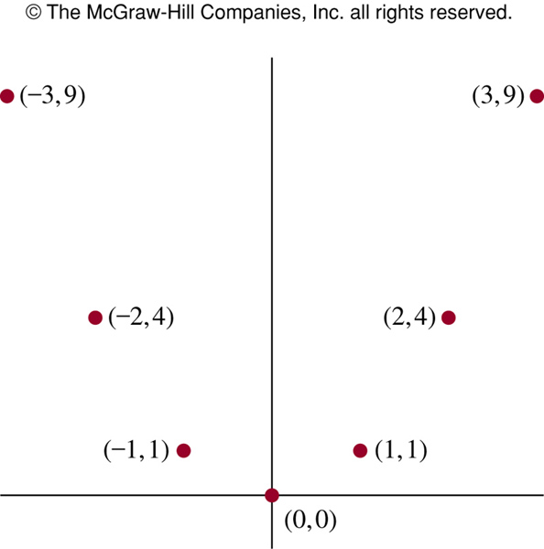
FIGURE 9 (2.3)
FIGURE 9 The Graph of f(x) = x² from Z to Z.
Notes:
p:\msoffice\My Projects\Rosen 6e 2007\Imagebank\JPEGs07-24-06\ch02\jpeg\02-3-009.jpg

Slide 50
Floor and Ceil Functions
Definition 12: The floor function assigns to x the largest integer that is less than or equal to x (⎣x⎦ or [x])..
Definition 13: The ceiling function assigns to x the smallest integer that is greater than or equal to x (⎡x⎤)

Slide 51
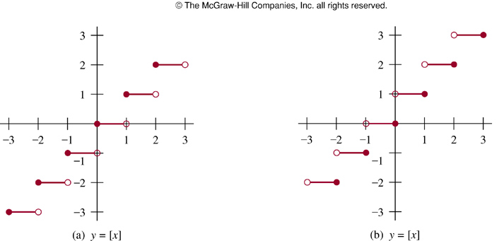
FIGURE 10 (2.3)
FIGURE 10 Graphs of the (a) Floor and (b) Ceiling Functions.
Notes:
p:\msoffice\My Projects\Rosen 6e 2007\Imagebank\JPEGs07-24-06\ch02\jpeg\02-3-010.jpg

Slide 52
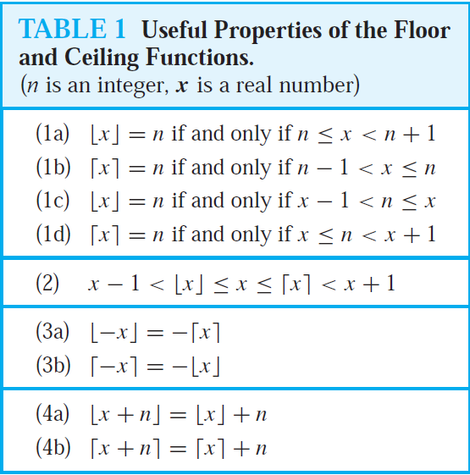
TABLE 1 (2.3)
Notes:
p:\msoffice\My Projects\Rosen 6e 2007\Imagebank\JPEGs07-24-06\ch02\jpeg\t02-3-01.jpg

Slide 53
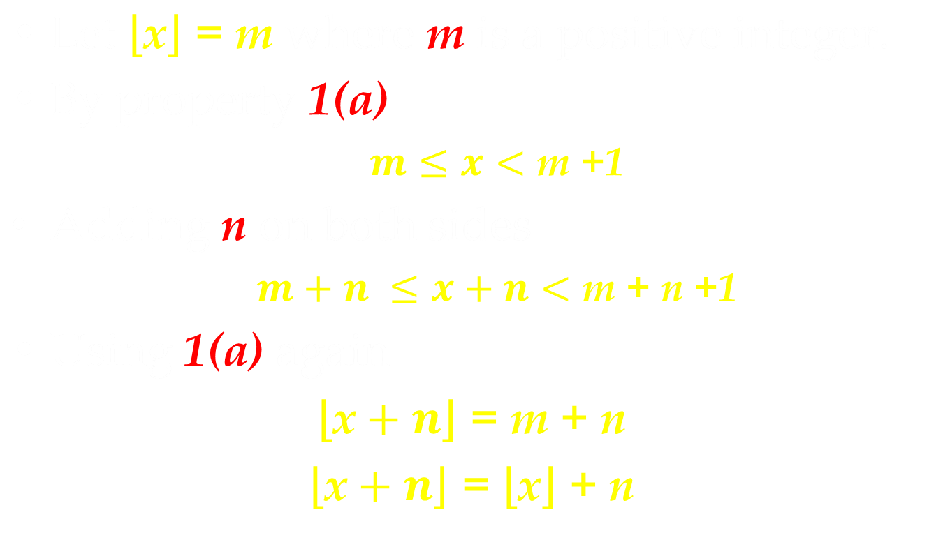
Proof: 4(a)

Slide 54
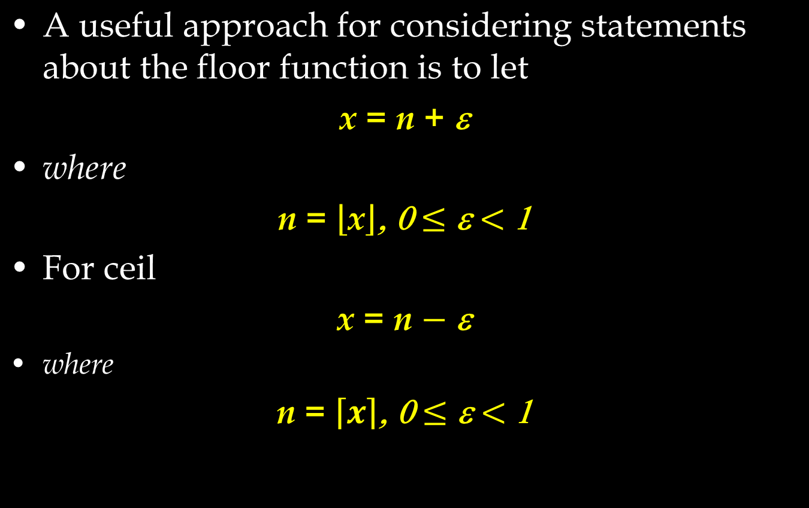

Slide 55

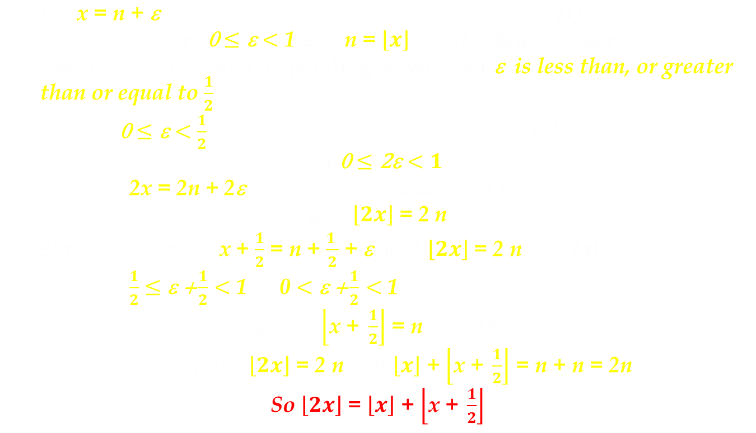

Slide 56
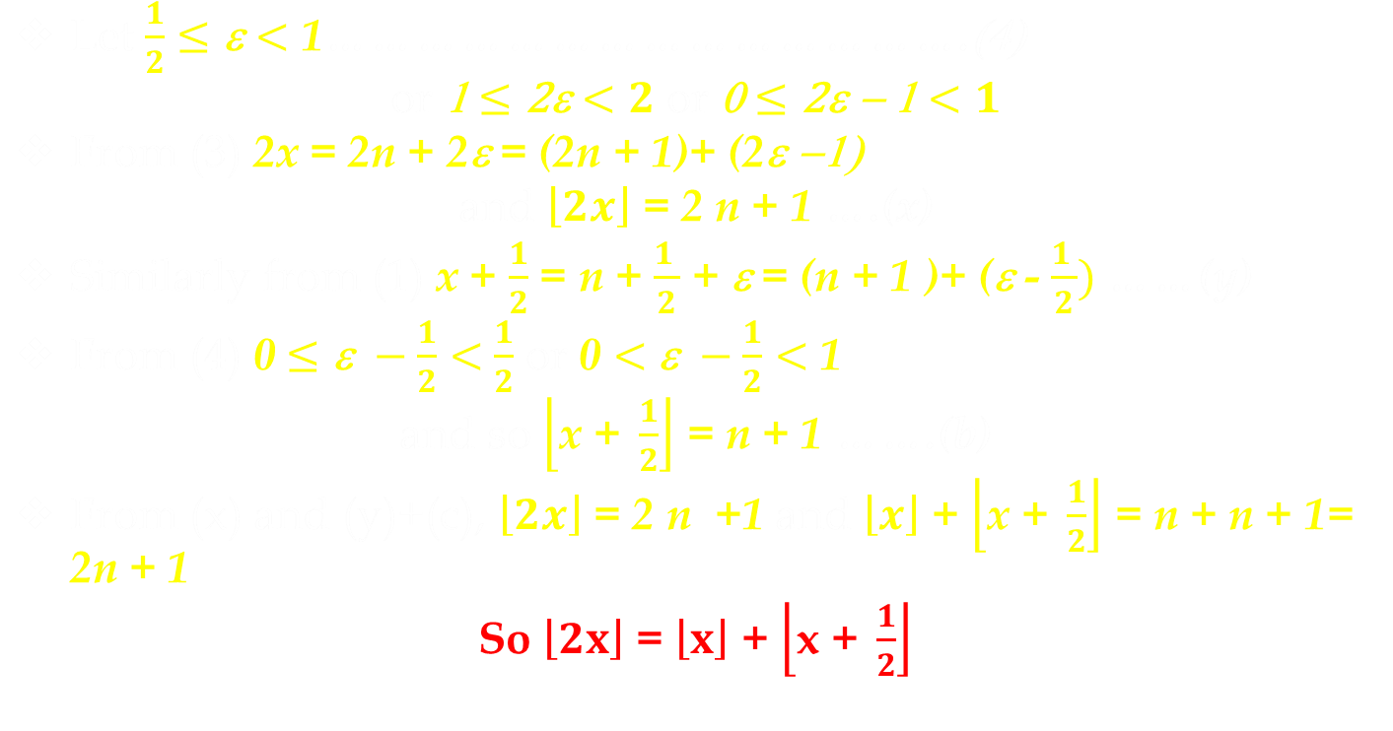

Slide 57
Getting Started
2.1 Sets
2.2 Set Operations
2.3 Functions
2.4 Sequences and Summations

Slide 58
2.4 Sequences and Summations
Definition 1: A sequence is a function from a subset of the set of integers to a set S. We use a_{n} to denote the image of the integer n (a term of the sequence)
The sequence {a_{n}}
Ex: a_{n}=1/n

Slide 59
Definition 2: A geometric progression is a sequence of the form a, ar, ar², …, ar^{n}, … where the initial term a and the common ratio r are real numbers
Definition 3: A arithmetic progression is a sequence of the form a, a+d, a+2d, …, a+nd, … where the initial term a and the common difference d are real numbers

Slide 60
Ex. 1, 3, 5, 7, 9, …
Ex. 1, 2, 2, 3, 3, 3, 4, 4, 4, 4, …
Ex. 1, 7, 25, 79, 241, 727, 2185, 6559, 19681, 59047, …

Slide 61
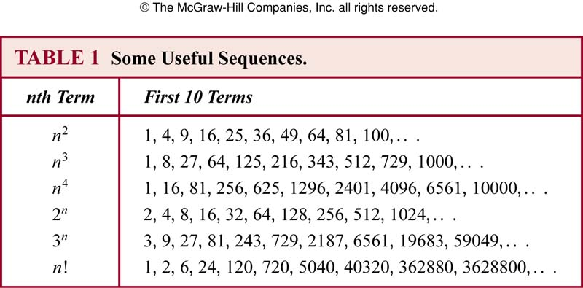
TABLE 1 (2.4)
Notes:
p:\msoffice\My Projects\Rosen 6e 2007\Imagebank\JPEGs07-24-06\ch02\jpeg\t02-4-01.jpg

Slide 62
Summing a Sequence
Specific sum
1 + 2 + 3 + ….. + n-1 + n
General summation of a sequence of terms:
a₁ + a₂ + …… a_{n}
a_{k} terms
where k = 1 , 2 , … n

Slide 63
Summing a Sequence
Each element a_{k} of a sum is called a term.
The terms are often specified implicitly as formulas that follow a readily perceived pattern.
In such cases we must sometimes write them in an expanded form so that the meaning is clear.

Slide 64
Summing a Sequence
1 + 2 + ……….
1 + 2 + ….. + 2^{n-1}
1 + 2 + 4 + ……. + 2^{n-1}
2⁰ + 2¹ + 2² + ……. + 2^{n-1}
The three-dots notation has many uses, but it can be ambiguous and a bit long-winded

Slide 65
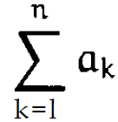

Delimited Form of Sum
Three-dots notation is vague and wordy
which is also called Sigma-notation because it uses the Greek letter

Slide 66
Delimited Form of Sum
Parts of notation
Summand
Index variable
Lower limit
Upper limit

Slide 67

Delimited Form of Sum
Sigma notation inline

Slide 68
Delimited Form of Sum
Sums the terms a_{k} where index k is an integer from lower limit 1 to upper limit n
or
sum over k from 1 to n

Slide 69
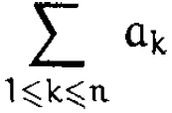
Generalized Sigma-Notation
Specify a condition that the index variable must satisfy
We simply write one or more conditions under the to specify the set of indices over which summation should take place.

Slide 70
Generalized Sigma-Notation
The general form allows us to take sums over index sets that aren’t restricted to consecutive integers.

Slide 71
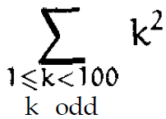
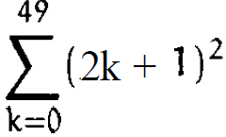
Generalized Sigma-Notation
Express the sum of the squares of all odd positive integers below 100
The delimited equivalent of this sum

Slide 72
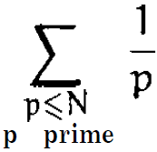
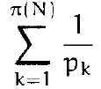
Generalized Sigma-Notation
The sum of reciprocals of all prime numbers between 1 and N
The delimited equivalent of this sum
π(N) = Number of primes given

Slide 73
Advantage of Generalized Sigma-Notation
We can manipulate it more easily than the delimited form

Slide 74


Advantage of Generalized Sigma-Notation
Change the index variable k to k + 1
Generalized Sigma-notation
Delimited form

Slide 75
Advantage of Delimited Form
It’s nice and tidy, and we can write it quickly
Needs less symbol than generalized sigma notation.
=

Slide 76
Delimited Form Vs. Generalized Sigma-Notation
Delimited Form
Used in presenting or stating a problem
Generalized Sigma-Notation
Used when index variable needs to be transformed.

Slide 77
Summations
Summation notation:
a_{m}+a_{m+1}+…+a_{n}
j: index of summation
m: lower limit
n: upper limit

Slide 78
Theorem 1 (geometric series): If a and r are real numbers and r≠0, then
Prove it yourself

Slide 79
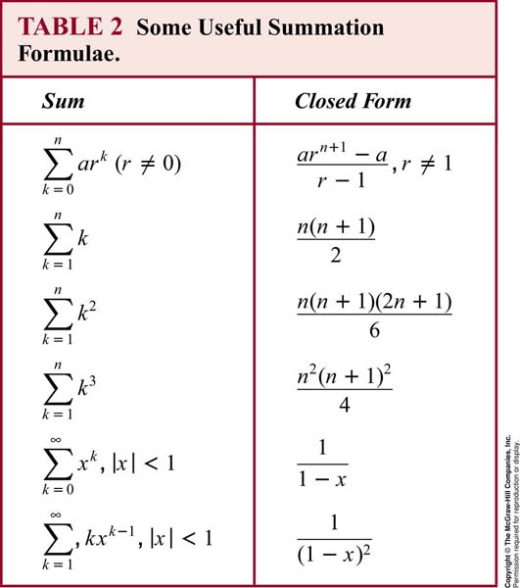
TABLE 2 (2.4)
Notes:
p:\msoffice\My Projects\Rosen 6e 2007\Imagebank\JPEGs07-24-06\ch02\jpeg\t02-4-02.jpg

Slide 80
Cardinality
Definition 4: The sets A and B have the same cardinality iff there is a one-to-one correspondence from A to B.
Definition 5: A set that is either finite or has the same cardinality as the set of positive integers is called countable. A set that is not countable is called uncountable. When an infinite set S is countable, |S|=א₀ (“aleph null”)
Ex: the set of odd positive integers is countable

Slide 81
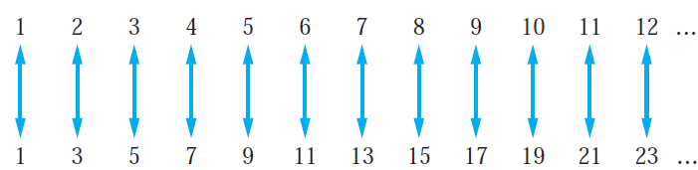
FIGURE 1 (2.4)
FIGURE 1 A One-to-One Correspondence Between Z⁺ and the Set of Odd Positive Integers, f(n) = 2n - 1.
Notes:
p:\msoffice\My Projects\Rosen 6e 2007\Imagebank\JPEGs07-24-06\ch02\jpeg\02-4-001.jpg

Slide 82
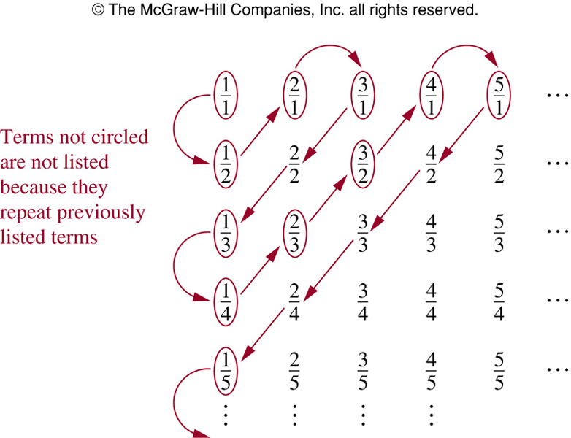

FIGURE 2 (2.4)
FIGURE 2 The Positive Rational Numbers Are Countable.
歐亞書局
P. 159
Notes:
p:\msoffice\My Projects\Rosen 6e 2007\Imagebank\JPEGs07-24-06\ch02\jpeg\02-4-002.jpg

